Slide 1
NXT Showcase 2021 Documentation
By: Omar Elemary

Slide 2
GameManager
Singleton
The connection point between the simpleAPI and the game entities
Creates and contains all the in-game entities.
Updates game entities.

Slide 3
GameEntity
Serves as the base class for all game entities.
Sets up a system to set one entity as a parent for easier transformations.

Slide 4
SpriteEntity
Derived from the GameEntity base class.
The building block for all the game graphics.
Is used by all visible objects on the screen.

Slide 5
TowerEntity
Derived from the GameEntity base class.
Defines all logic of towers in the game.

Slide 6
Player
Derived for the GameEntity base class.
Handles the player’s data.

Slide 7
Enemy
Derived for the GameEntity base class.
Defines enemy logic.

Slide 8
Map
Derived for the GameEntity base class.
Renders tiles for map and creates towers on map

Slide 9
Tile
Defines tile types and logic

Slide 10
Level
Derived for the GameEntity base class.
Manages all logic of the level

Slide 11
Feature Set

Slide 12
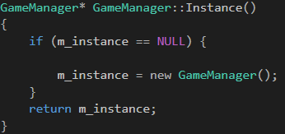
Singleton GameManager
Constructor is private, to make sure no instances are accidentally made.
This is to prevent any accidental initialization of multiple game managers leading to complications.
When the game manager instance is accessed, the same instance is always returned

Slide 13
One base class for all entities
This allows for a much faster development time, as the base class outlines most of the redundant features to be reused.
This also allows the developer to set one entity as a parent of another, even if they do not share the same type.

